Slide 1
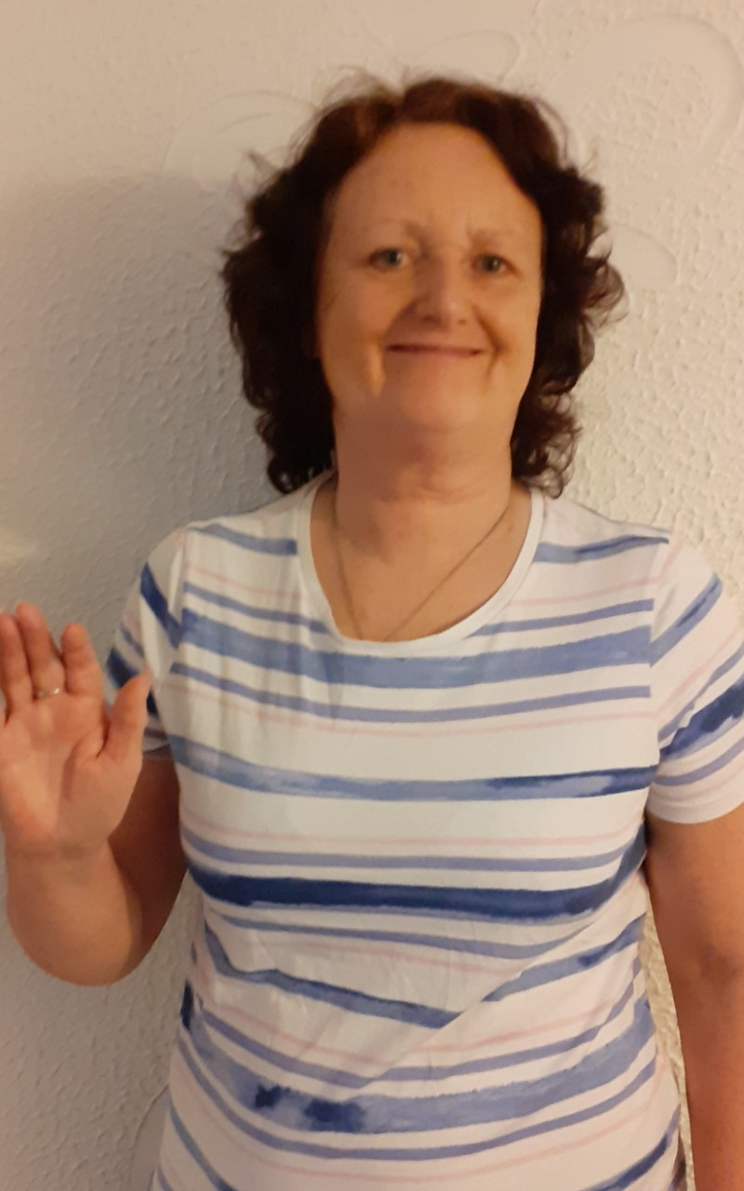
Meet The Teacher
Mrs Williams
My favourite colour is blue, and I love to wear blue clothes. I like to go for walks with my daughter’s little dogs and I like to watch football. My favourite football team is Aston Villa. My favourite food is strawberries, but I love chocolate too especially Galaxy. The subject I like teaching best is Maths, but I also love reading stories.
Photo
My Favourites
When I was a little girl, I always wanted to be a teacher
and I used to play “school “with my teddies. Since I became a real teacher, I have taught lots of different age groups, but my favourite is Reception. At Parkfield we work hard but have lots of fun ! I live with my husband and have a son called Ross and a daughter called Michelle. Recently I had a new baby grandson which was very exciting for me. Starting school can be a little scary, but please don’t worry. I will be there to help you and you will soon settle in. I am really looking forward to being your teacher and can’t wait to meet you!
A Little Bit About Me

