Slide 1
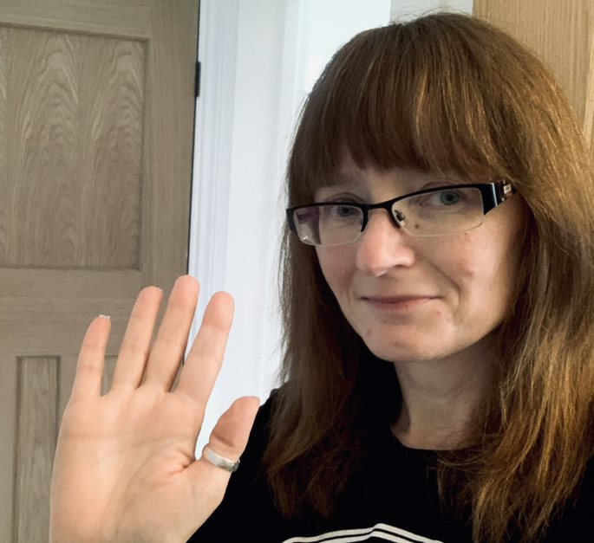
Meet The Teacher
Mrs Greatorex
I have two favourite colours red and blue. My favourite thing to do at home is baking. I love making bundt cakes and eating them! I collect cookbooks and love trying out different recipes. My favourite book of all time is The Lion, the Witch and the Wardrobe By C.S. Lewis. My favourite film is National Velvet. I named my cat after the horse in the film.
My Favourites
I qualified as a teacher in 1997 after completing a 4 year degree and teaching course in the North East. I stayed in the North East at the same school, teaching Year 1 and 2 for 6 years. I moved to Birmingham in 2003 and taught Year 3 and Year 5 at another school. I have been at Parkfield Community School since 2005. I loved it so much I've been here for 15 years, teaching in Year 1 and now Reception. I am married and have 2 cats called Pye and Yippee.
Starting school can be a little scary for some and that’s ok. I will support and guide you every step of the way. You will make lots of friends and have lots of fun in Reception! I am really looking forward to being your teacher, we can have fun and learn together. Prepare yourself for an exciting year ahead in Poppy Group!
A Little Bit About Me

